Slide 1




Enhancing Data Analytics at Atliq Hardwares
Animesh Daniel
Atliq Hardwares is expanding its analytics team to drive data-informed decision-making and insights.

Slide 2






Introduction to Atliq Hardwares
01
Company Overview
04
Hiring Criteria
Atliq Hardwares stands as a prominent producer of computer hardware in India, recognized for its innovative solutions and quality products. The company has successfully expanded its reach into international markets, establishing a strong global presence.
Tony Sharma, the Director of Data Analytics, is looking to recruit junior data analysts who possess a balanced skill set. Candidates must demonstrate strong technical expertise in data analysis tools and programming, alongside essential soft skills such as communication and teamwork.
02
Insights Needed
The management team at Atliq Hardwares has identified a critical gap in their decision-making process. They require enhanced insights to enable swift, data-informed decisions that can drive the company’s strategic initiatives and operational efficiency.
05
SQL Challenge for Assessing Skills
To effectively evaluate potential hires, Tony Sharma has devised a SQL challenge. This practical assessment will not only test candidates' technical abilities in SQL but also provide insights into their problem-solving approaches and soft skills during collaborative tasks.
03
Expansion Plans for Data Analytics Team
In response to the identified need, Atliq Hardwares plans to expand its data analytics team significantly. This growth is aimed at equipping the company with the analytical capabilities necessary to leverage data for competitive advantage.

Slide 3
Task Overview
A Step-by-Step Guide to Delivering Insights
01
Review Ad Hoc Requests
Begin by examining the 'ad-hoc-requests.pdf' document, which contains 10 specific ad hoc requests that require insights from the business. Each request is critical for decision-making and must be understood in detail to provide accurate responses.
02
Run SQL Queries
Utilize SQL queries to extract relevant data needed to answer the identified ad hoc requests. This involves gathering insights from the database to ensure that the management team has access to accurate and relevant information for their strategic discussions.
03
Create Dashboard for Insights
Develop a comprehensive dashboard that presents insights derived from the SQL queries. The dashboard should be visually appealing and easy to interpret, catering specifically to the needs of top-level management who require clear and concise information to guide their decisions.
04
Engage the Audience Creatively
Incorporate creative elements into the presentation, to enhance engagement and retention of information among top-level management. This will help in making the insights more relatabe and memorable.

Slide 4
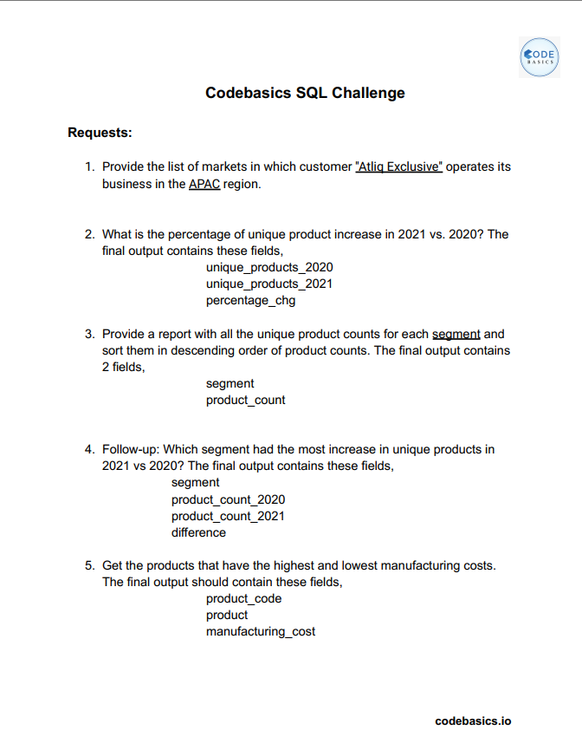
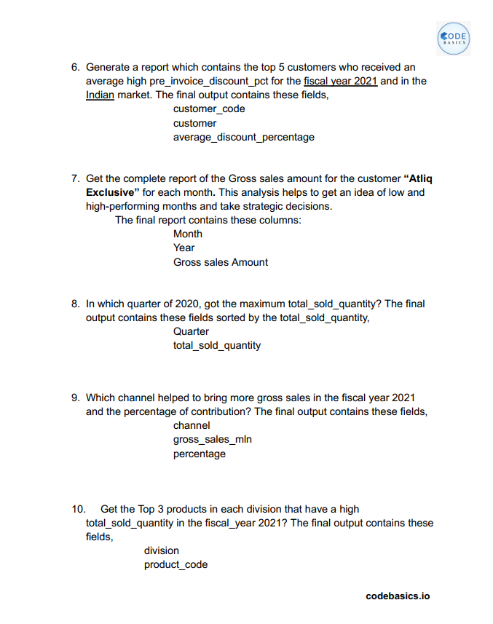
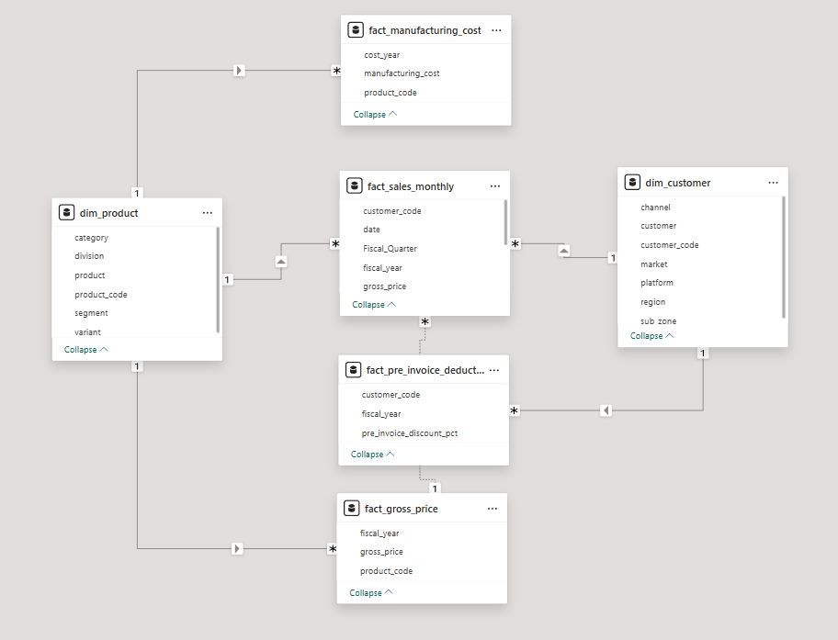
Tools, Data, Requests
Using SQL for data processing and Power BI for visualization to efficiently fulfill requests.

Slide 5






Markets in APAC for Atliq Exclusive
Overview of Atliq Exclusive's presence in the Asia-Pacific markets
01
02
03
India
Indonesia
Japan
One of the largest and fastest-growing markets, with a strong customer base and established operations
A key Southeast Asian market with rising demand for computer hardware and technology solutions.
A highly developed tech market, providing opportunities for innovation and premium product offerings.
04
05
06
Philippines
South Korea
Australia
A rapidly expanding digital economy, driving demand for high-performance computing products.
A global tech powerhouse with a strong focus on cutting-edge hardware and gaming solutions.
A strategic location serving as a gateway to Southeast Asia, backed by a well-developed market.

Slide 6
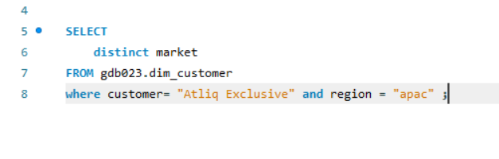
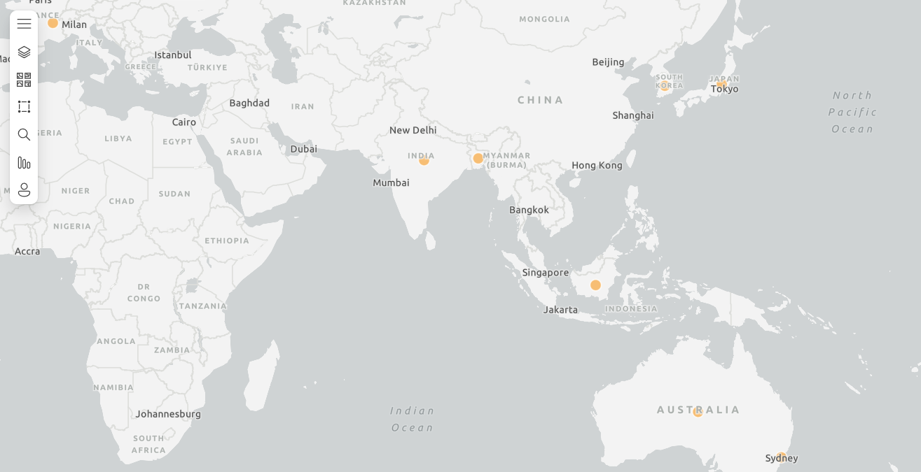
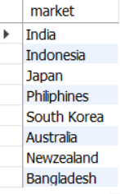
SQL Queries and Power BI Presentation
Visualizing Data with Tables and ArcGIS Map

Slide 7




Unique Products in 2020: 1,000
Stable base established in 2020
In 2020, the company had a solid foundation with 245 unique products, which set the stage for future growth.
Unique Product Increase Percentage
Unique Products in 2021: 1,200
Analysis of Unique Product Growth
Significant growth in unique offerings
In 2021, the total number of unique products increased to 334, demonstrating a successful expansion of the product line.
Percentage Change: 36.33%
Robust growth rate indicates market demand
The 36.33% increase in unique products suggests a positive market response and an opportunity to further capitalize on consumer preferences.

Slide 8
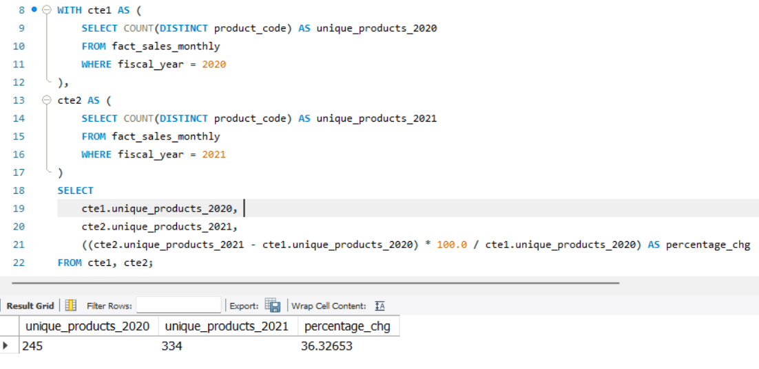
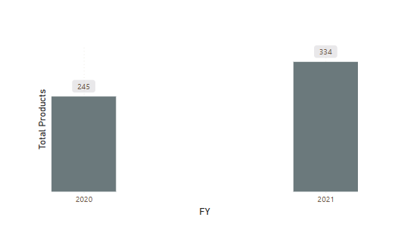
SQL Queries and Power BI Presentation
Visualizing Data with Graphs and Tables

Slide 9



Unique Product Counts by Segment
Sorted in Descending Order
Segment
Product Count
Notebook
129
Accessories
116
Peripherals
84
Desktop
80
Storage
27
Networking
9

Slide 10
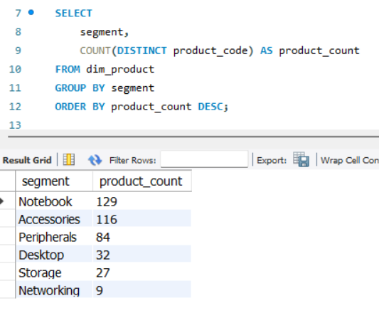
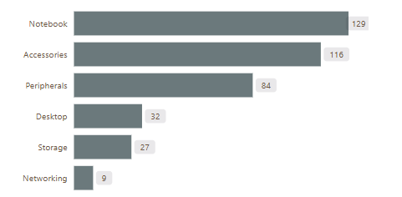
SQL Queries and Power BI Presentation
Visualizing Data with Graphs and Tables

Slide 11









Segment with Most Increase in Unique Products
Analysis of Product Growth Across Different Segments for 2021
Segment
Product Count 2020
Product Count 2021
Difference
Accessories
69
103
34
Notebook
92
108
16
Peripherals
59
75
16
Desktop
7
22
15
Storage
12
17
5

Slide 12
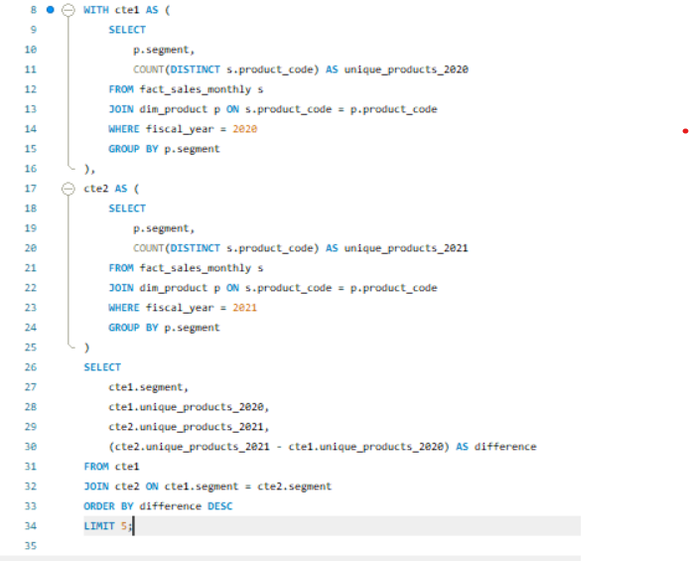
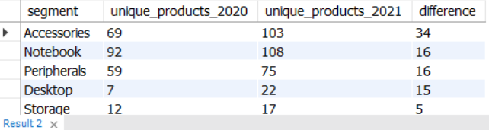
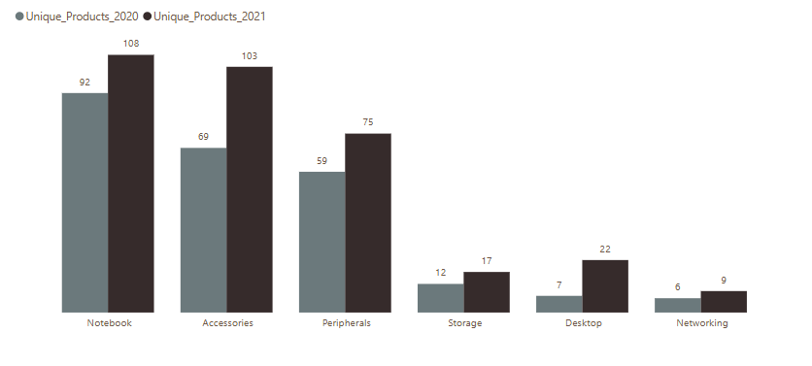
SQL Queries and Power BI Presentation
Visualizing Data with Graphs and Tables

Slide 13




Manufacturing Costs Overview
Comparison of Products Based on Manufacturing Costs
Product Code
Product
Manufacturing Cost
A2118150101
AQ Master wired x1 Ms
$0.89
A6120110206
AQ HOME Allin1 Gen 2
$240.5

Slide 14
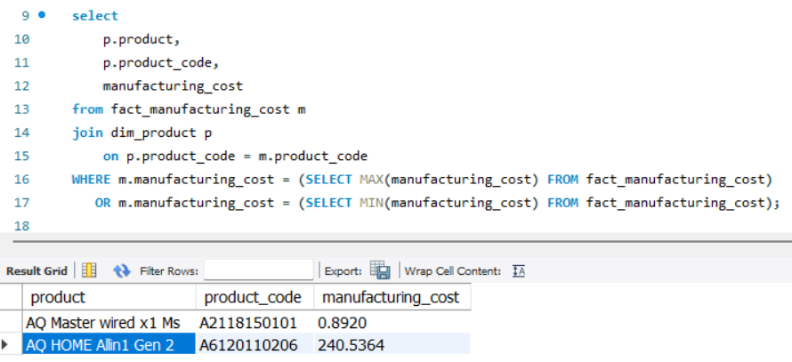
SQL Queries and Power BI Presentation
Visualizing Data with Graphs and Tables

Slide 15









Top Customers by Discount for FY 2021
A detailed report showcasing the top 5 customers who benefited from discounts in the Indian market during fiscal year 2021.
Customer Code
Customer Name
Average Discount Percentage
90002009
Flipkart
30.83%
90002006
Viveks
30.38%
90002003
Ezone
30.28%
90002002
Croma
30.25%
90002016
Amazon
30.33%

Slide 16
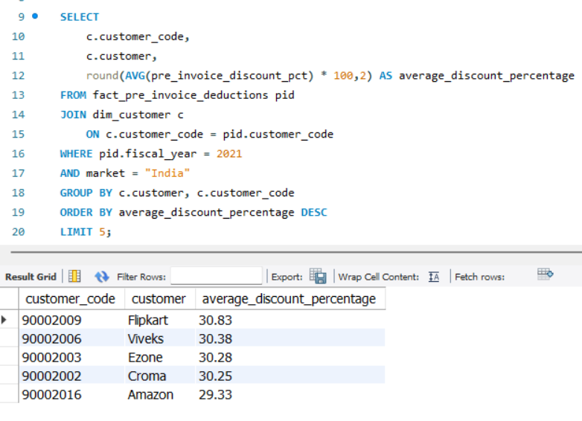
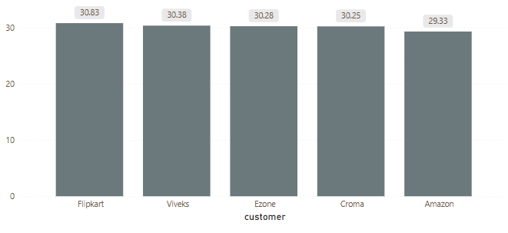
SQL Queries and Power BI Presentation
Visualizing Data with Graphs and Tables

Slide 17






Gross Sales Report for Atliq Exclusive
Monthly Sales Data
Month
Year
Gross Sales Amount
January
2020
$9584951.94
February
2020
$8083995.55
March
2020
$766976.45
April
2020
$800071.95
May
2020
$1586964.48
June
2020
$3429736.57
July
2020
$5151815.40

Slide 18
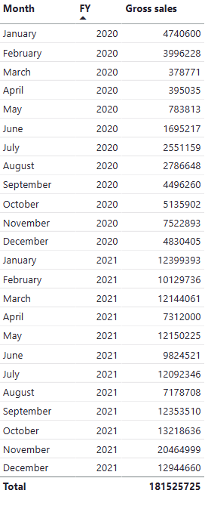
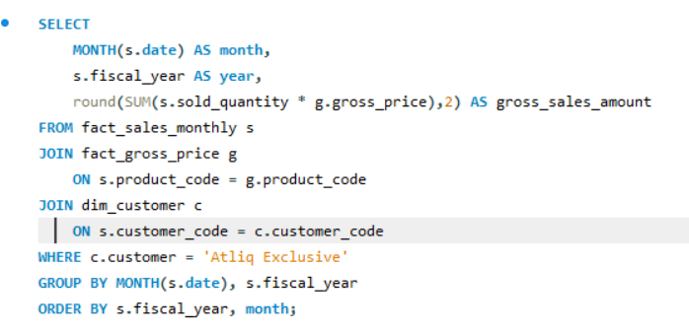
SQL Queries and Power BI Presentation
Visualizing Data with Graphs and Tables

Slide 19
Maximum Sold Quantity by Quarter
Analyzing the Total Sold Quantity by Quarter in 2020
Q1 2020 shows a notable sales figure
Sales in Q2 2020
Sales peak in Q3 2020
Sales drop in Q4 2020
Q1 2020: 3.4M units
Q2 2020: 5.2M units
Q3 2020: 8.4M units
Q4 2020: 3.7M units
In the first quarter of 2020, a total of 3.4M units were sold, indicating a strong start to the year. This data suggests effective marketing strategies in place during this period.
The second quarter saw a remarkable surge, with 5.2M units sold. This growth could be attributed to expanded distribution channels or the launch of a new product line.
The third quarter recorded an impressive 8.4M units sold, marking the highest sales volume of the year. This spike could be attributed to seasonal demand or successful promotional campaigns.
Sales dipped to 3.7M units in the fourth quarter, which may indicate market saturation or the impact of external economic factors. Analyzing customer feedback during this time could provide insights for recovery.

Slide 20
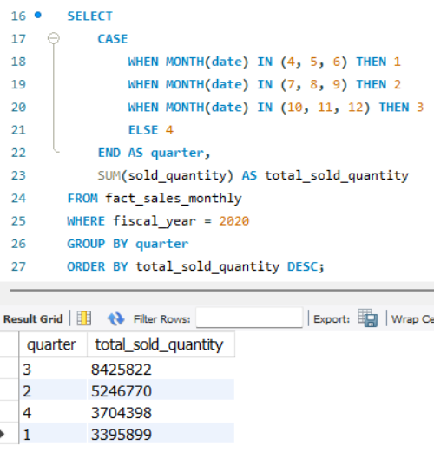
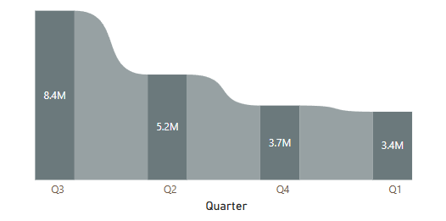
SQL Queries and Power BI Presentation
Visualizing Data with Graphs and Tables

Slide 21



Sales Channels Contribution for Fiscal Year 2021
Analyzing the impact of various sales channels on gross sales in FY 2021
1.9billion
406.6million
297million
Retailer Channel generated the highest gross sales.
Direct Channel followed behind.
Distributor Channel’s role in total sales.
Retailer channel contributed 1.9 billion in gross sales, representing a significant portion of the overall sales figures for the fiscal year 2021. This channel's strong performance highlights its effectiveness in reaching customers and driving revenue.
With gross sales amounting to 406.6 million, direct channel accounted for a substantial contribution. Its growth suggests an increasing customer preference for this channel, calling for enhanced focus in future marketing strategies.
Distributor channel generated 297 million in gross sales. Although it ranks third, its contribution is critical, emphasizing the diverse channels needed to optimize overall sales performance.

Slide 22
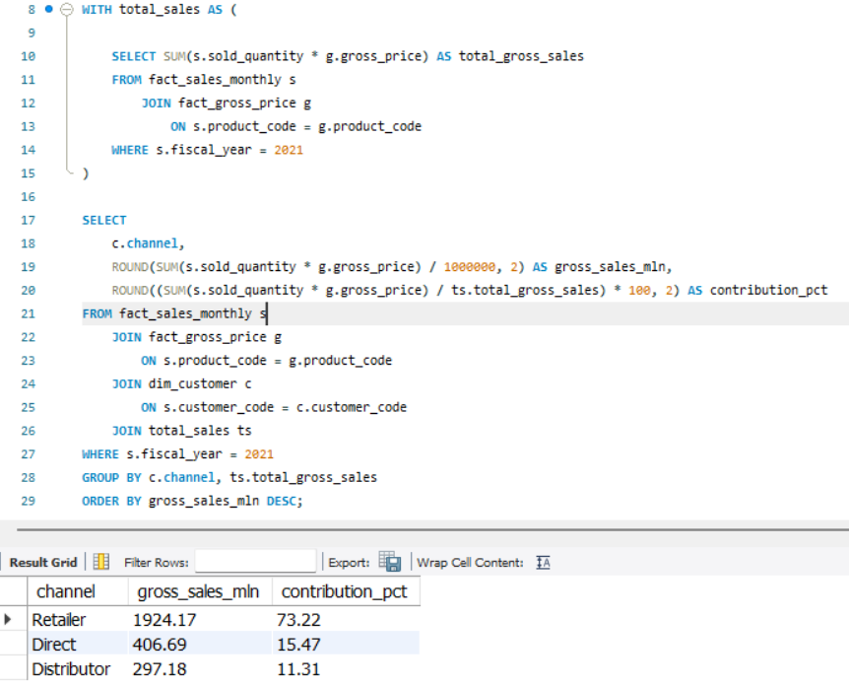
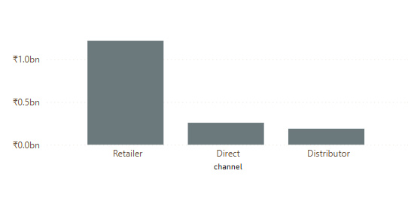
SQL Queries and Power BI Presentation
Visualizing Data with Graphs and Tables

Slide 23


Top Products by Division
Discover the leading products across various divisions based on their sales performance for the fiscal year 2021.
Division
Product Code
N & S
AQ Pen Drive 2 IN 1
N & S
AQ Pen Drive DRC
N & S
AQ Pen Drive DRC
P & A
AQ Gamers Ms
P & A
AQ Maxima Ms
P & A
AQ Maxima Ms
PC
AQ Digit

Slide 24

Top Products by Division
Discover the leading products across various divisions based on their sales performance for the fiscal year 2021.
Division
Product Code
PC
AQ Velocity
PC
AQ Digit

Slide 25
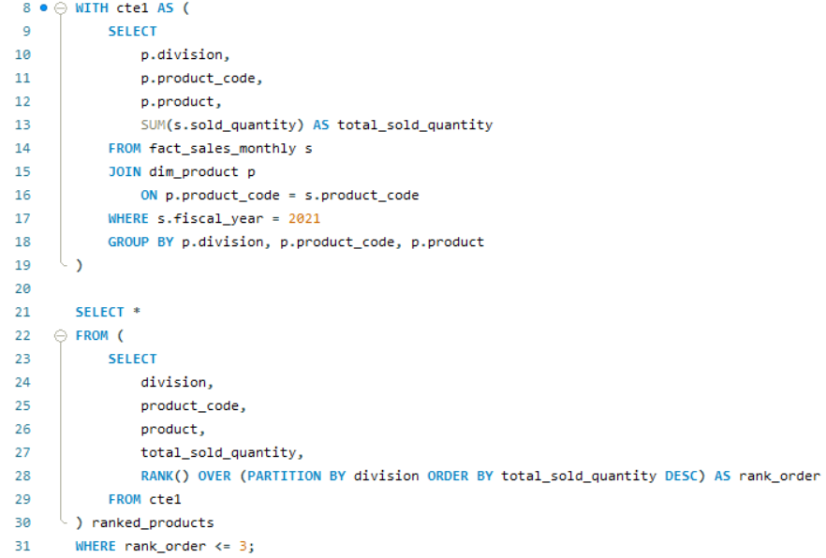
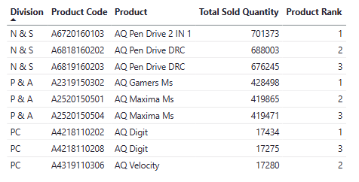
SQL Queries and Power BI Presentation
Visualizing Data with Graphs and Tables

